Slide 1

Cloud-Based Movie Streaming Platform Using Next.js and FastAPI
Members:
Mustakim Ahmed Hasan (2421349042)
Tanim Ahmed (2312597042)
Nafiz Al Mamun (2232050642)
Ahamed Osman Asif (2031080642)
Notes:
Group 1
Mustakim Ahmed Hasan (2421349042)
Tanim Ahmed (2312597042)
Nafiz Al Mamun (2232050642)
Ahamed Osman Asif (2031080642)

Slide 2

Introduction
Online streaming is now the main entertainment source
Platforms like Netflix require multiple subscriptions
Building such systems requires frontend + backend + database + cloud
Goal: build a simplified Netflix-like platform
Notes:
Group 1
Mustakim Ahmed Hasan (2421349042)
Tanim Ahmed (2312597042)
Nafiz Al Mamun (2232050642)
Ahamed Osman Asif (2031080642)

Slide 3

Problem Statement
Multiple subscriptions are expensive
No centralized platform for content
Academic projects lack real-world complexity
Missing features:
authentication
streaming
deployment
scalable architecture
Notes:
Group 1
Mustakim Ahmed Hasan (2421349042)
Tanim Ahmed (2312597042)
Nafiz Al Mamun (2232050642)
Ahamed Osman Asif (2031080642)

Slide 4

Project Objectives
Build full-stack streaming platform
Implement authentication (login/register)
Provide movie browsing and search
Implement video playback (HLS)
Store user data and watch history
Deploy system on cloud
Notes:
Group 1
Mustakim Ahmed Hasan (2421349042)
Tanim Ahmed (2312597042)
Nafiz Al Mamun (2232050642)
Ahamed Osman Asif (2031080642)

Slide 5
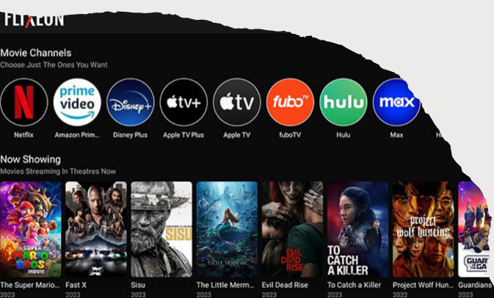
Technology Stack
Frontend:
Next.js, React, TypeScript
Tailwind CSS
Backend:
FastAPI, Python
SQLAlchemy, asyncpg
Database:
PostgreSQL (Supabase)
Other:
HLS.js (video streaming)
Vercel (deployment)
Notes:
Group 1
Mustakim Ahmed Hasan (2421349042)
Tanim Ahmed (2312597042)
Nafiz Al Mamun (2232050642)
Ahamed Osman Asif (2031080642)

Slide 6
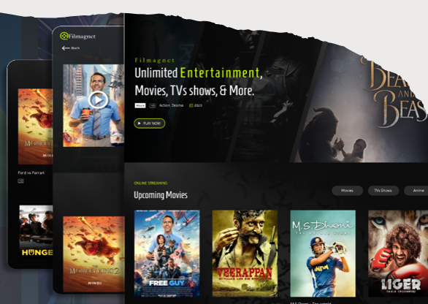
System Architecture
Three-layer system:
User → Frontend → Backend → Database
Frontend: UI + user interaction
Backend: logic + API + authentication
Database: stores users, movies, history
Media: HLS video from cloud storage
Notes:
Group 1
Mustakim Ahmed Hasan (2421349042)
Tanim Ahmed (2312597042)
Nafiz Al Mamun (2232050642)
Ahamed Osman Asif (2031080642)

Slide 7

Key Features
User authentication (JWT)
Movie browsing and details
Typo-tolerant search
HLS video streaming
Watch history tracking
Continue watching feature
Responsive UI
Notes:
Group 1
Mustakim Ahmed Hasan (2421349042)
Tanim Ahmed (2312597042)
Nafiz Al Mamun (2232050642)
Ahamed Osman Asif (2031080642)

Slide 8
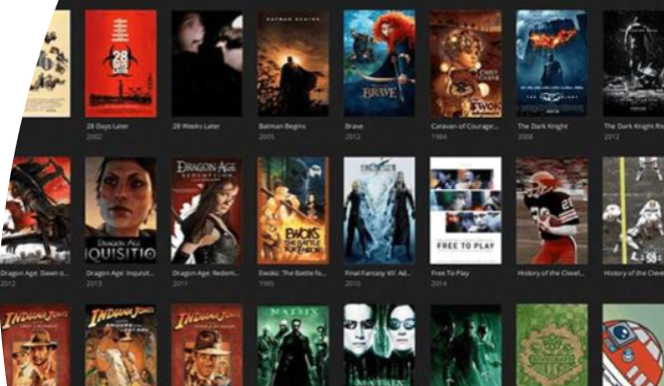
Frontend Design
Built using Next.js App Router
Pages: home, login, search, history, movie details
Components:
Navbar (SiteHeader)
MovieCard
Player
RouteGuard
Features:
loading skeletons
responsive UI
search integration
Notes:
Group 1
Mustakim Ahmed Hasan (2421349042)
Tanim Ahmed (2312597042)
Nafiz Al Mamun (2232050642)
Ahamed Osman Asif (2031080642)

Slide 9
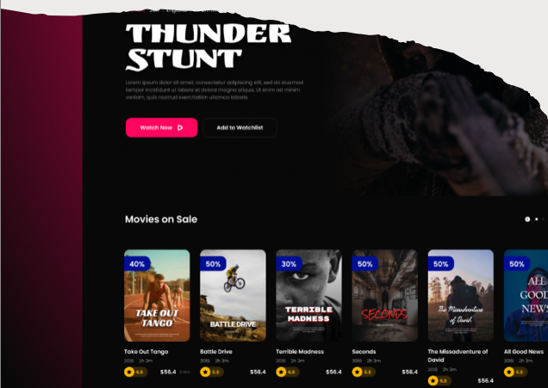
Backend Design
Built using FastAPI
Main APIs:
/auth → login/register
/movies → list/search/details
/history → watch progress
Uses dependency injection
Uses async database queries
Notes:
Group 1
Mustakim Ahmed Hasan (2421349042)
Tanim Ahmed (2312597042)
Nafiz Al Mamun (2232050642)
Ahamed Osman Asif (2031080642)

Slide 10
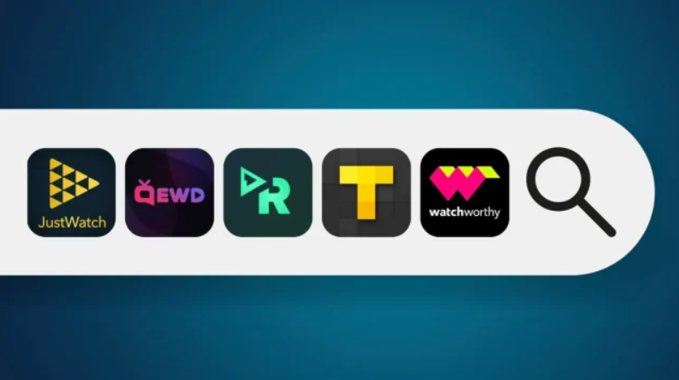
Search Functionality
Improved from exact match → smart search
Backend ranking system:
exact match
prefix match
substring match
token overlap
fuzzy similarity
Supports typo search
Example: "spidreman" → "Spider-Man"
Notes:
Group 1
Mustakim Ahmed Hasan (2421349042)
Tanim Ahmed (2312597042)
Nafiz Al Mamun (2232050642)
Ahamed Osman Asif (2031080642)

Slide 11
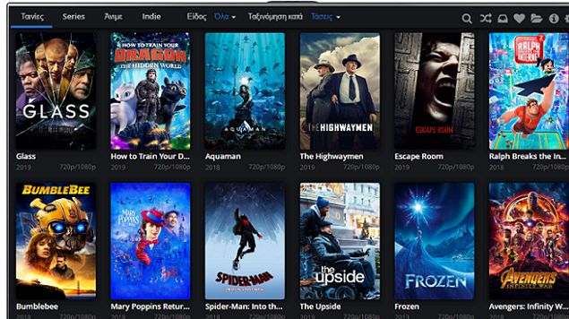
Video Player & Streaming
Uses HLS (.m3u8) streaming
Player features:
play/pause
seek forward/backward
volume + mute
fullscreen
subtitles
Uses hls.js for browser support
Tracks watch progress
Notes:
Group 1
Mustakim Ahmed Hasan (2421349042)
Tanim Ahmed (2312597042)
Nafiz Al Mamun (2232050642)
Ahamed Osman Asif (2031080642)

Slide 12
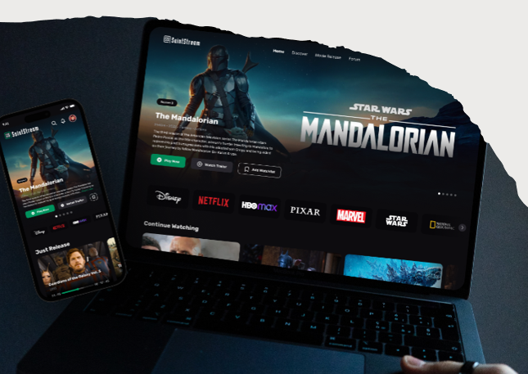
Deployment & Challenges
Deployment:
Frontend → Vercel
Backend → Vercel
Database → Supabase
Challenges solved:
CORS issues
serverless DB connection
auth across domains
asyncpg conflicts
UI loading states
Notes:
Group 1
Mustakim Ahmed Hasan (2421349042)
Tanim Ahmed (2312597042)
Nafiz Al Mamun (2232050642)
Ahamed Osman Asif (2031080642)

Slide 13
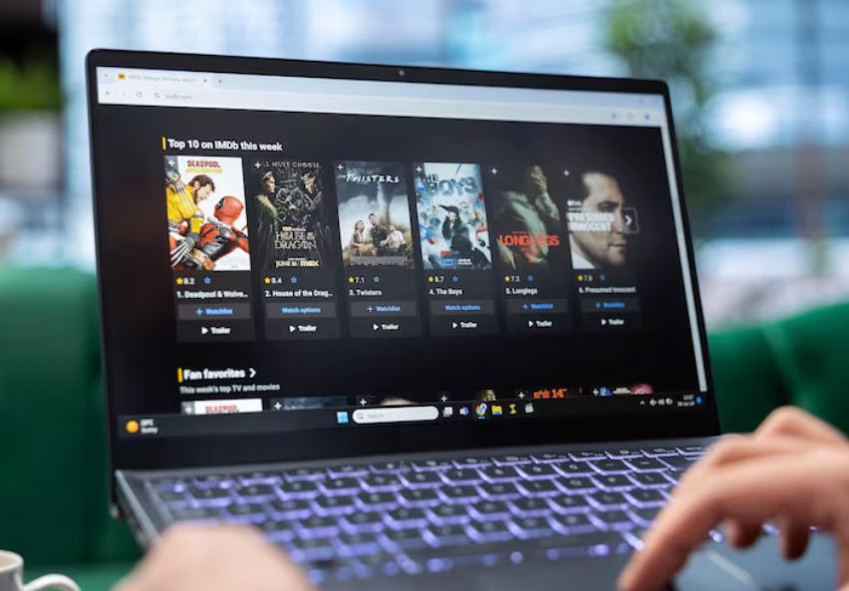
Demo Slide
Login/Register
Homepage browsing
Search (typo example)
Movie player
History / Continue Watching
Notes:
Group 1
Mustakim Ahmed Hasan (2421349042)
Tanim Ahmed (2312597042)
Nafiz Al Mamun (2232050642)
Ahamed Osman Asif (2031080642)

Slide 14
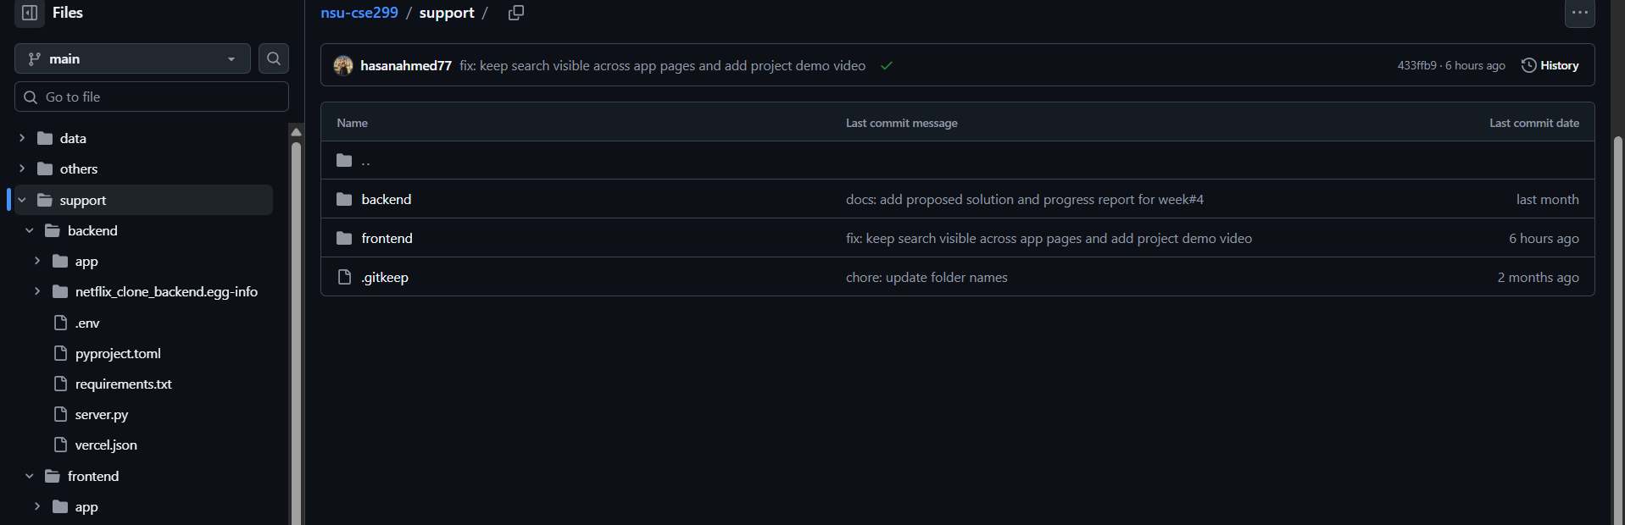
GitHub
Project structure (frontend/backend)
Important folders
README
Commits
Notes:
Group 1
Mustakim Ahmed Hasan (2421349042)
Tanim Ahmed (2312597042)
Nafiz Al Mamun (2232050642)
Ahamed Osman Asif (2031080642)

Slide 15
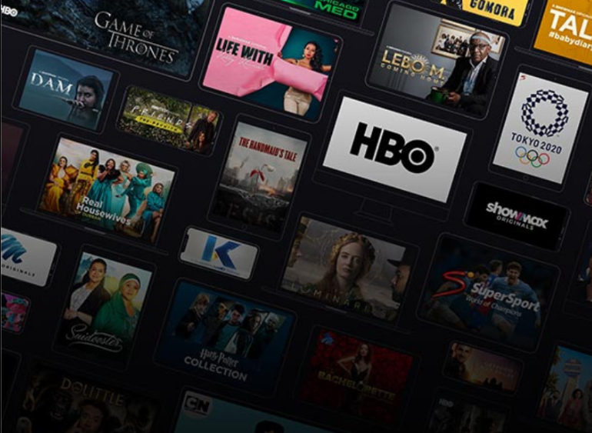
Conclusion
Built a full-stack streaming platform
Implemented real-world architecture
Integrated frontend, backend, and cloud
Solved deployment challenges
Gained practical full-stack experience
Notes:
Group 1
Mustakim Ahmed Hasan (2421349042)
Tanim Ahmed (2312597042)
Nafiz Al Mamun (2232050642)
Ahamed Osman Asif (2031080642)

Slide 16

Notes:
Group 1
Mustakim Ahmed Hasan (2421349042)
Tanim Ahmed (2312597042)
Nafiz Al Mamun (2232050642)
Ahamed Osman Asif (2031080642)

